Slide 1
Recommendations To Do Park City Mini-Reunion
Flying Aces Friday Night Class Event
Saturday at Olympic Park
High West Distillery Tour
Mirror Lake Self Driving Tour
Mormon Tabernacle Choir Thursday Night Practice and Sunday Performance
Saturday Tee times. Tee times for foursomes at area golf courses will be available at Registration for those wanting to Golf Saturday
Southern Utah National Park Tour (Before or After Mini-Reunion)

Slide 2
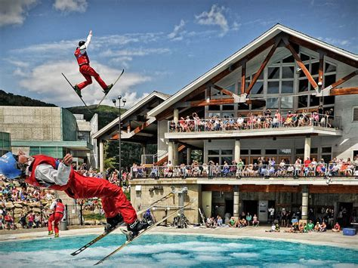
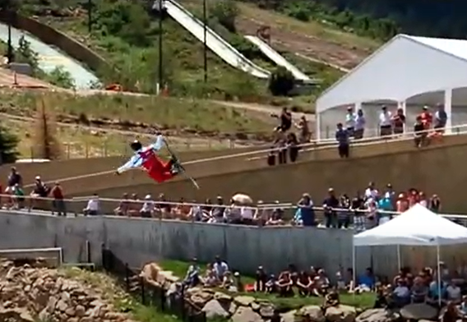
Flying Aces Friday at 6:00 PM on August 27
This is a performance you do not want to miss. This is a half hour show starting at 6:00 pm at the Olympic Park. The performers are Olympic aerobatic skiers. We are combining the show with our Class night banquet. We will meet at the Summer Pavilion, which will open at 5:00 pm. Enter through the Alf Engen Museum. Dinner will follow the show. The Alphorn group, Salzburger Echo, will also perform.
Summer Pavilion

Slide 3
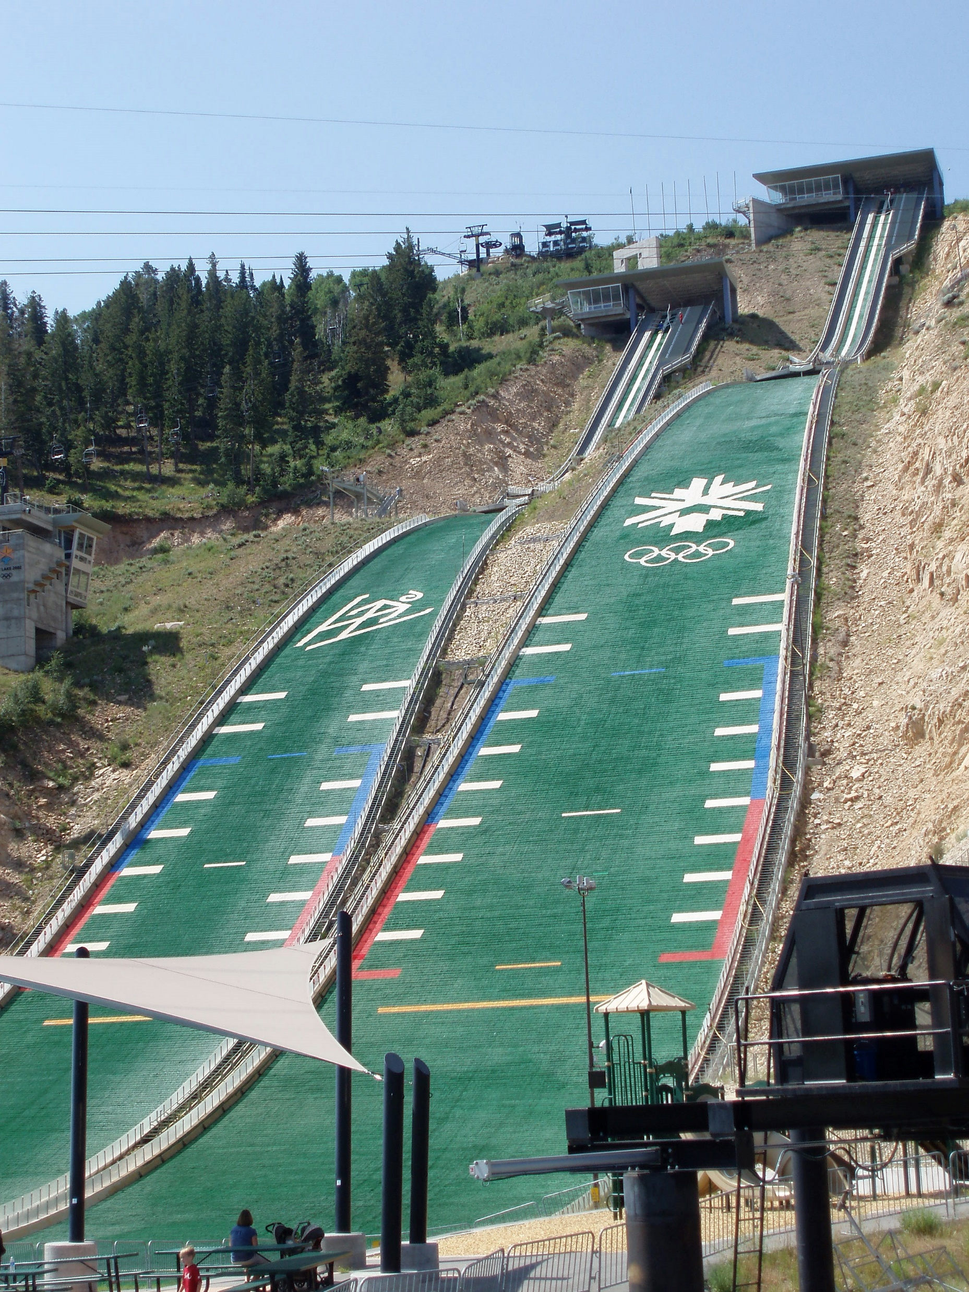
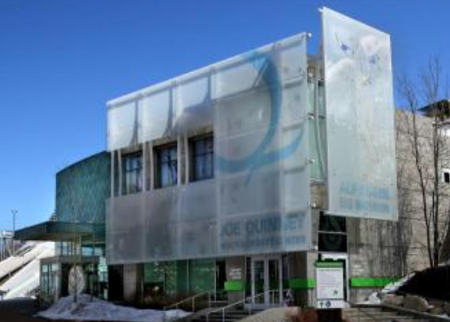
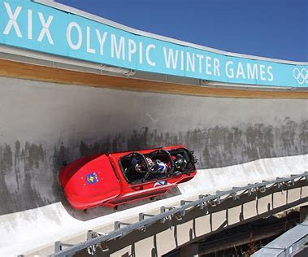
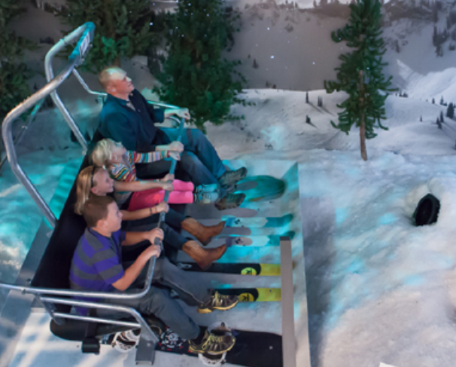
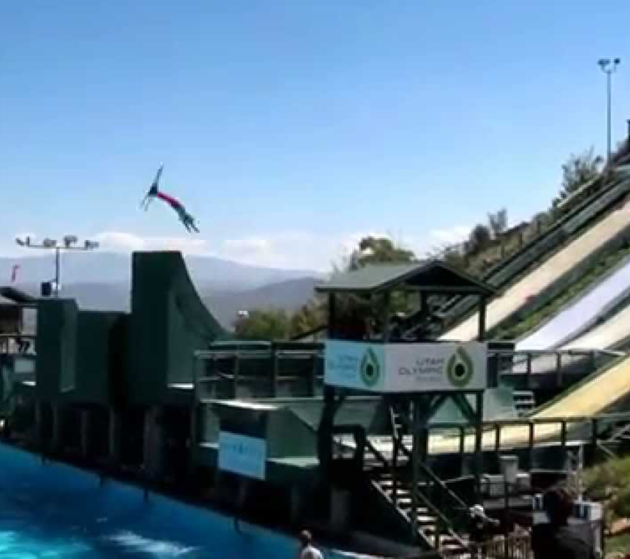
Saturday at the Utah Olympic Park (Optional)
The Utah Olympic Park is TripAdvisor’s #1 Park City attraction. Saturday in the best day to visit the park. The Utah Olympic Park was built for the 2002 Olympics ski jump, luge and bobsled events. For a real trill, ride with a professional bobsled driver on the Olympic bobsled course at speeds over 60 miles an hour as Bob Powers and his wife did last summer. The Alf Engen Museum has outstanding displays of Park City’s ski history and is free. Tickets are available for Extreme Tubing, Alpine Slide, and Extreme Zip Line.
The reason Saturday is the best day to visit is to watch 60- and 90-meter ski jump training and see skiers practicing aerobatic jumps into a pool.

Slide 4
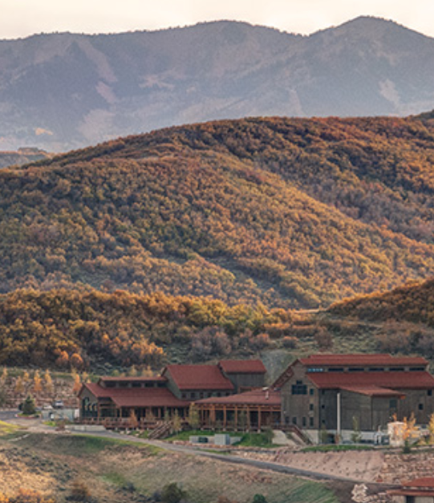
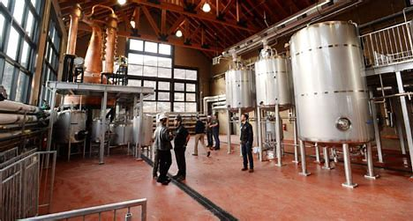
High West Distillery Tour
High West Whiskey is a premium whiskey distilled about a half hour east of Park City in a beautiful mountain setting. It is a great place to have lunch and combine that with tour of the distillery, which is offered Thursday – Sunday at 11:30 am, 1:00 pm and 2:30 pm. It is a complimentary tour. They do offer and charge for an optional whiskey flight. Because of Covid, currently they are only offering a Sensory Tour. However, the tour group size is small, and I expect that tours will begin shortly and should be available this summer. Since space is limited, call ahead at 435-649-8300 to reserve spots.

Slide 5
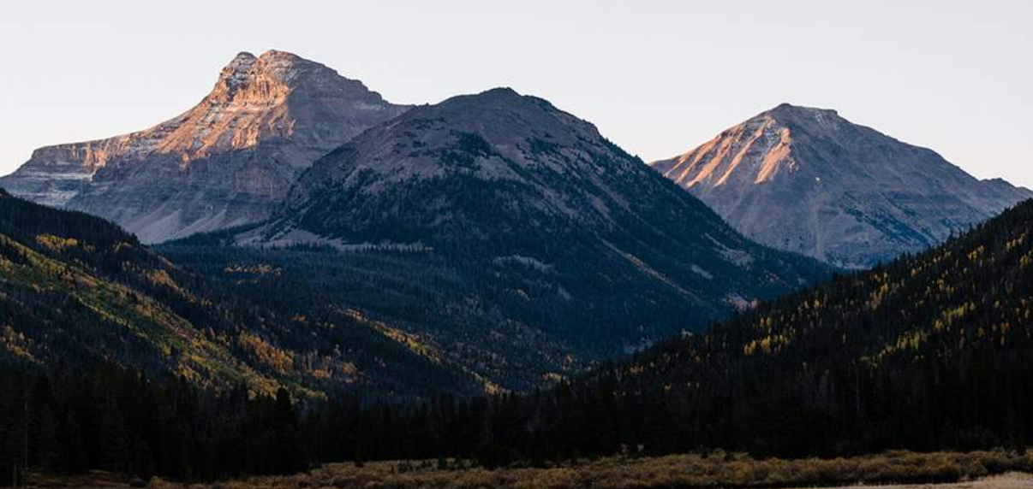
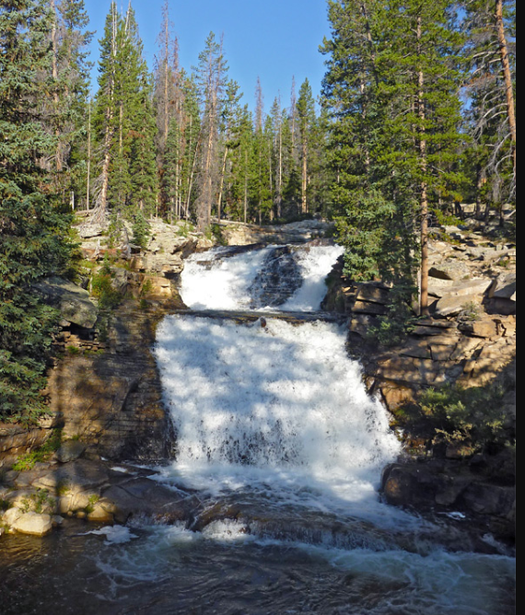
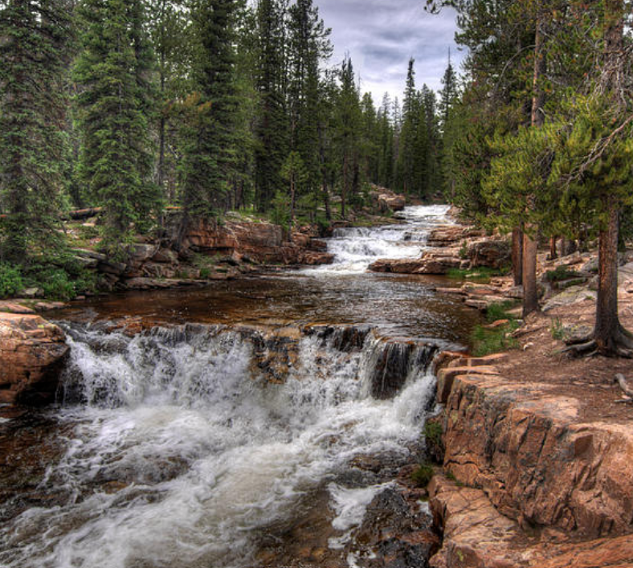
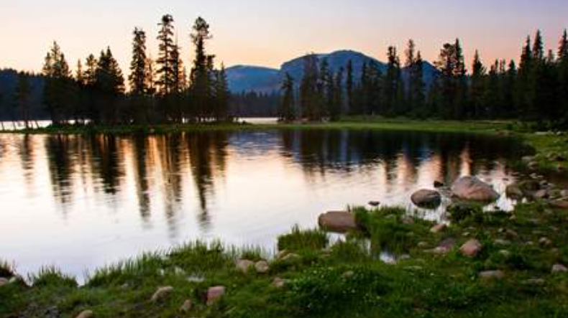
Mirror Lake Self Driving Tour
One of the most scenic drives in Utah is the Mirror Lake scenic drive. It begins in Kamas, Utah and ascends high into the Uinta Mountains cresting at 10,715 feet at Bald Mountain Pass, and then descends past Mirror Lake. I recommend stopping to see Provo Falls on the way. Mirror Lake is a great site for a picnic. There are many hiking trails. The drive continues into Evanston, Wyoming, but I recommend returning on the same route from Mirror Lake. A nice place for lunch is the Dejoria Center in Kamas. Good chance of seeing a moose on this drive.

Slide 6
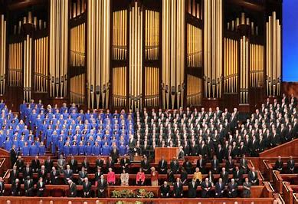
Tabernacle Choir Thursday Night Practice and Sunday Performance
You have two options to see the Tabernacle Choir. Both are currently suspended because of Covid, but hopefully will be open to the public this summer.
One, If you have the time Sunday morning, seeing the Tabernacle Choir perform is amazing. There is a live broadcast of “Music and the Spoken Word” which features the Tabernacle Choir on Sunday mornings at 9:30 am. It is held at the Conference Center in the summer and parking is free on Sundays. Admission is free. Doors open to the public at 8:30 a.m., and guests should be seated by 9:15 a.m., when the doors are closed. The broadcast is 30 minutes in length and ends at 10:00 a.m. If you are flying out of the Salt Lake Airport, try to schedule a flight out after 1:00 pm.
The second opportunity is to see them is when they practice on Thursday Night, 7:30-9:30 pm

Slide 7
Sample Itinerary To Visit the Five National Parks in Southern Utah
This is a summary of a five-day trip, day by day, to see five National Parks in Southern Utah, which are referred to now as the Mighty Five. If you are renting a car, an all-wheel or four-wheel drive vehicle is not necessary, however there are a number of off-road places that you may want to visit along this route. If you are short on time, just do the Moab two or three-day tour. Five days is the minimum I would recommend to see all the parks. (I wrote this before our scheduled Mini-Reunion last year).
I hope you have a Senior Pass for free access to the National Parks. If not, you should consider getting either the Lifetime Senior Pass or the Annual Senior Pass. Even if you only plan on visiting just one National Park, it is worth getting Annual Senior Pass. Go here for information: Senior Pass Info. These Senior Passes are for you and three others in the vehicle.
Along this trip there are at least five Utah state parks you may also want to visit as well. Consider purchasing a Senior Utah State Park Pass. Utah State Park Senior Pass.
Vicki and I did this trip about ten years ago with my Uncle and Aunt. After the Sonoma mini-reunion, I went with Jim(H-1) and Doreen Mohney on this trip. I also went with Bill(H-1) and Loraine Hendrich on a two-day Moab tour. It is a great trip to take with another couple.
The trip leaves the Grand Summit, goes to Moab for two nights to see Arches, Canyonlands and Dead Horse Point State Park. You may want to spend another day in Moab. The third day is spent traveling Scenic Byway 12 from near Moab through Capitol Reef National Park toward Bryce National Park. The last two days are touring Bryce Canyon and Zion National Parks. If you are planning on taking the trip before the Mini-reunion, the trip will be quite similar if you start at Zion’s and end up in Moab. One consideration is booking rooms early.

Slide 8
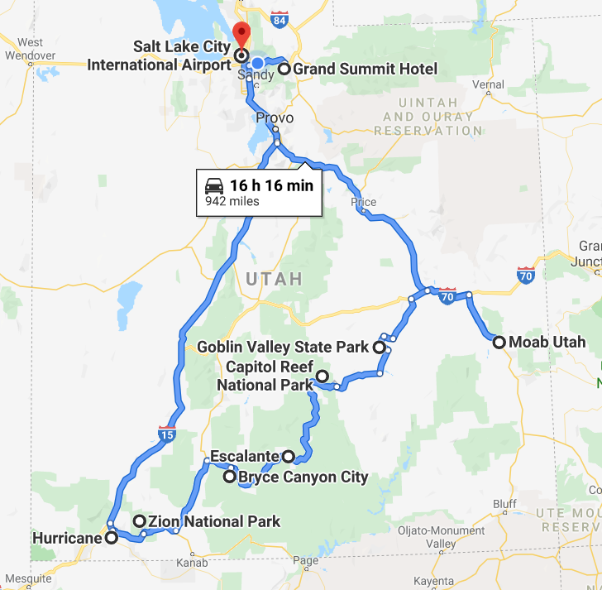

Slide 9
Following is my recommendation of a day-by-day trip scenario.
Moab. Home of Arches and Canyonlands National Parks and Dead Horse Point State Park. Day One
My recommendation for a place to stay in Moab is to use Airbnb and get one of the villas or condos by the golf course versus staying at a hotel, especially if traveling with another couple.
Driving Directions Go to Google Map Grand Summit to Moab
If you leave Grand Summit in Park City around 8:30 in the morning, I recommend you stop at Ray’s Tavern in Green River for hamburgers. I did a Moab golf trip with a friend and his recommendation to stop for lunch here was great. You should arrive around noon. Plan on seeing Dead Horse Point and Canyonlands before checking in if you can do a late arrival to your room. Either site is great in the afternoon to sunset.
A good place for dinner that night is the pub/restaurant at the Moab Brewery (Moab Brewery Website)

Slide 10
Day Two
If you are looking for a challenge, the hike up to the Delicate Arch is pretty spectacular. It is a 3-mile round trip hike with 480 feet of elevation gain. This hike, plus time to view the arch, takes most people 2 to 3 hours. The hike is rated moderate to strenuous. Go first thing in the morning as it is still hot around Labor Day. Carry at least two liters of water per person. You can see the Delicate Arch from below, but the closest view from the road is about a mile away. Spend the rest of the morning viewing the arches. You will have to go to Moab for lunch unless you carry it with you. Spend the afternoon visiting the rest of the park.
For dinner, I recommend the Desert Bistro ( Desert Bistro Website ) You will need reservations.
Add a Day Three Option in Moab Moab is known worldwide for the Slickrock Bike Trail. A difficult test for anyone and not for the casual mountain bike rider. This trail is not a beginner trail. There are very steep ascents and descents. Take lots of water the trail is nearly unshaded. Take lots of water. Again, plan on doing this in the morning. Take a look at this Trip Advisor review: Slickrock Bike Trail Review You can also rent all terrain vehicles and 4-wheel drive jeeps.
Moab is also famous for white water rafting trips on the Colorado River. Here is a link to Red River Adventure rafting tours, Trip Advisor’s top rated outfitters: Red River Adventure Rafting

Slide 11
Day Three
Scenic Byway 13 and 24
If you leave in the morning, the following route takes you to Bryce Canyon: Moab to Bryce Canyon Route .
Though this drive goes to Bryce Canyon, my recommendation is to spend the night in Escalante area and drive the next day to Bryce Canyon. There are some very good Bed and Breakfast places in the area.
This route includes Capitol Reef National Park and four Utah State Parks. The first is Goblin Valley State Park, which I have heard is worth the stop. I also recommend seeing the Anasazi State Park in Boulder, Utah. Try to have lunch or dinner at the Hell's Backbone and Grill . It has the reputation as one of the best restaurants in Utah.

Slide 12
Day 3 Continued.
I recommend taking the drive up the Hell’s Backbone Drive just outside of Boulder. It is a gravel road in good condition that leads to a one lane bridge across a ravine with spectacular views. After crossing the Bridge, there is a loop that takes you through the woods toward Escalante, I recommend after getting to the bridge, you return back toward Boulder. The loop is a 45-minute drive looking at a pine forest and you miss seeing some great views on Highway 12 from Boulder to Escalante.
There are two Utah State Parks near Escalante. I recommend visiting Kodachrome Basin an hour or so before sunset. The other park is Escalante Petrified Forest State Park and if you have not seen petrified wood, it is close to Highway 12 and does not take long.
If you are looking for a nice restaurant near Escalante, I recommend the North Creek Grill located at the Slot Canyon Inn, which is a great B&B.
If you have trouble finding a room in this area, you should have no problem finding one in the Bryce Canyon area about an hour away.

Slide 13
Day Four and Five
Bryce Canyon and Zion National Park
The following route starts in Escalante and goes to Bryce Canyon through Zion National Park and into Springdale Utah, just outside the south entrance into Zion: Bryce Canyon and Zion map
The best time to see Bryce Canyon is in the morning. Some spectacular views just off the Park road. I recommend going to the Bryce Canyon Lodge for lunch.
After lunch go to the East Gate at Zion and head into Springdale to check into your room. We stayed in the Park, but rooms are really difficult to reserve in all the parks. Springdale has some great B&B’s and many hotels. I do recommend booking early. Trip Advisor has some good restaurants in Springdale. We enjoyed eating in the Zion Park Lodge Red Rock Grill
Spend the fifth day in the Park.
Getting to the Airport. Here is a map to the Salt Lake City Airport Map to Salt Lake City Airport It is a 4 ½ hour drive. You may want to consider flying into Salt Lake City for the Mini-reunion and flying out of Las Vegas Airport as it is only 2 ½ hours away from Zion. Map to Las Vegas Airport
If you have questions, please feel free to contact me at 801-864-2643 or email at scottpeppler@gmail.com

