Slide 1
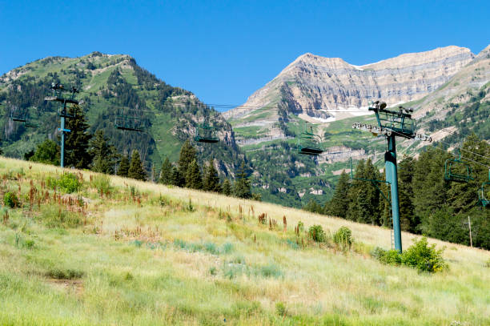
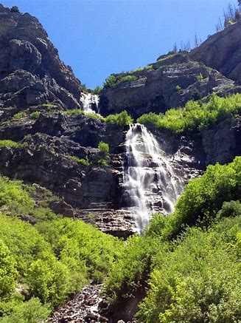
BUS TOUR OF SUNDANCE AND BRIDAL VEIL FALLS. Friday, August 27, 2021 $50.00 per person (Includes Lunch)

Slide 2
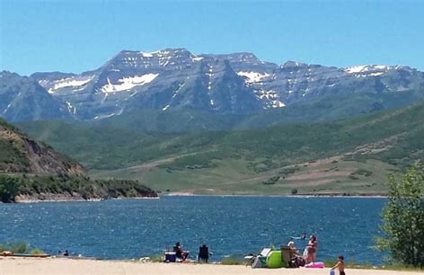
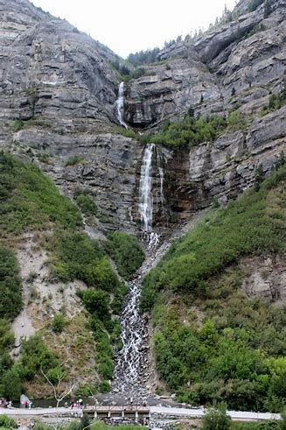
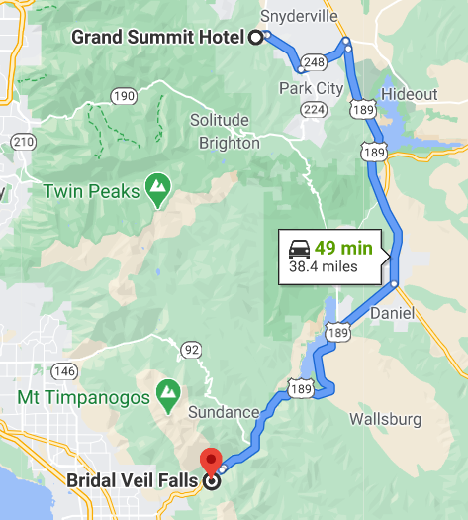
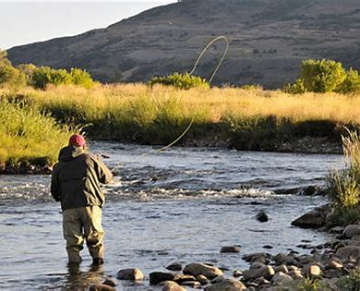
9:00 Depart Grand Summit Hotel
10:30 Bus Tour Provo Canyon With Half Hour Stop at Bridal Veil Falls

Slide 3
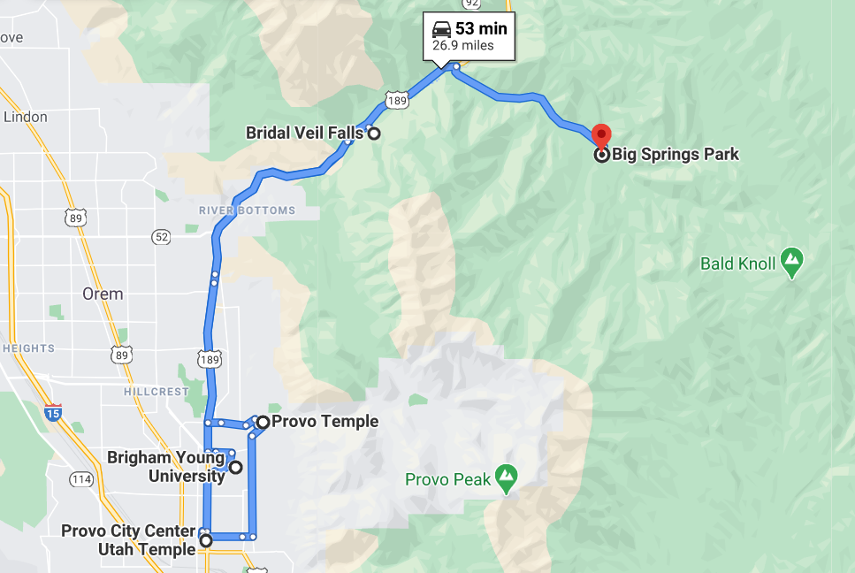
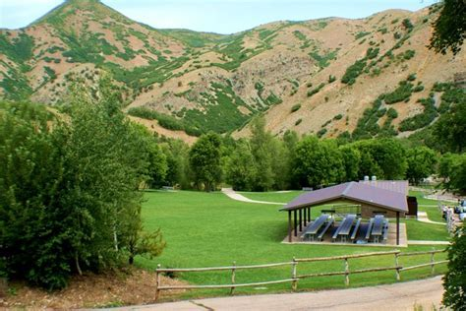
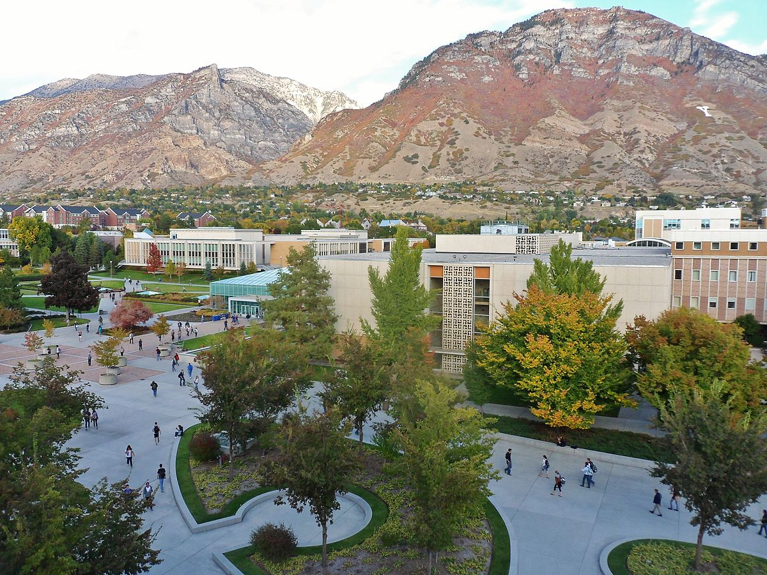
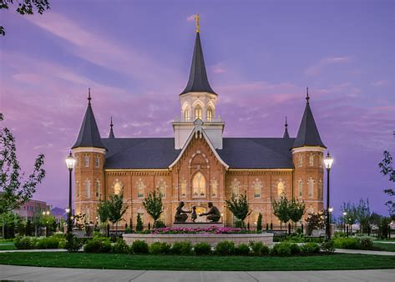
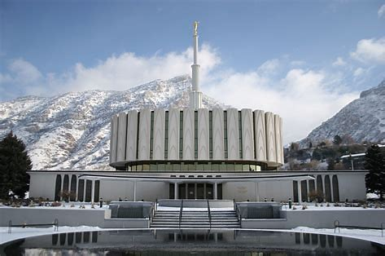
10:30 Bus Tour BYU Provo Temples
11:30 Catered Lunch Big Springs Park
12:15 Depart for Sundance

Slide 4
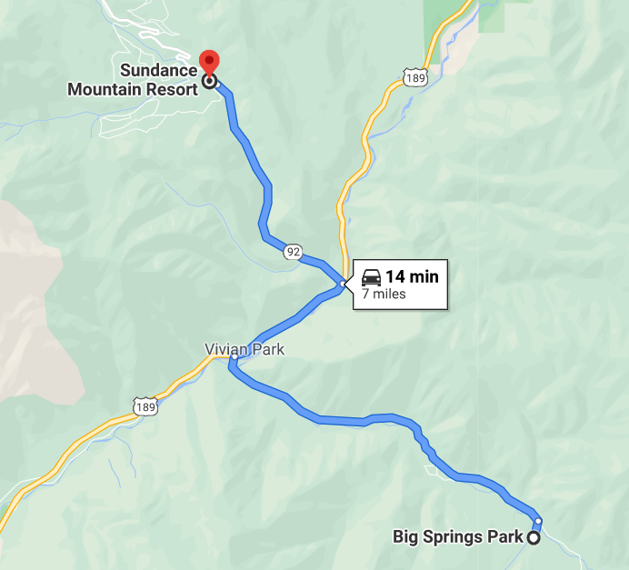
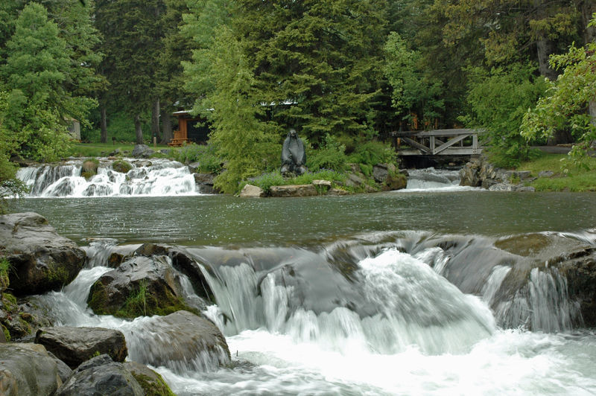
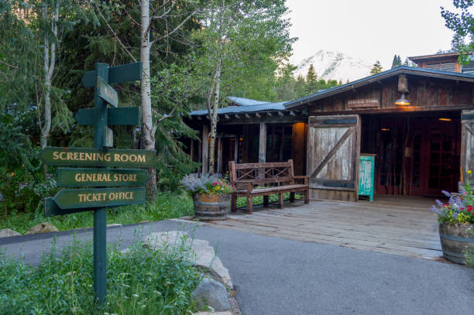
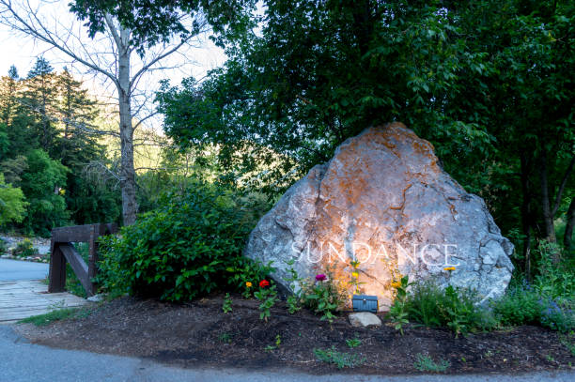
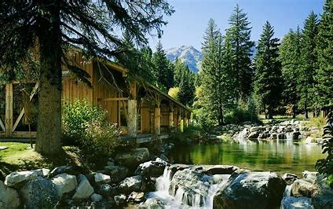
12:30 Arrive at Sundance Resort Walk on the Bridge Where Scott Proposed to Vicki
1:45-3:00 Depart To Return to Grand Summit

